Slide 1
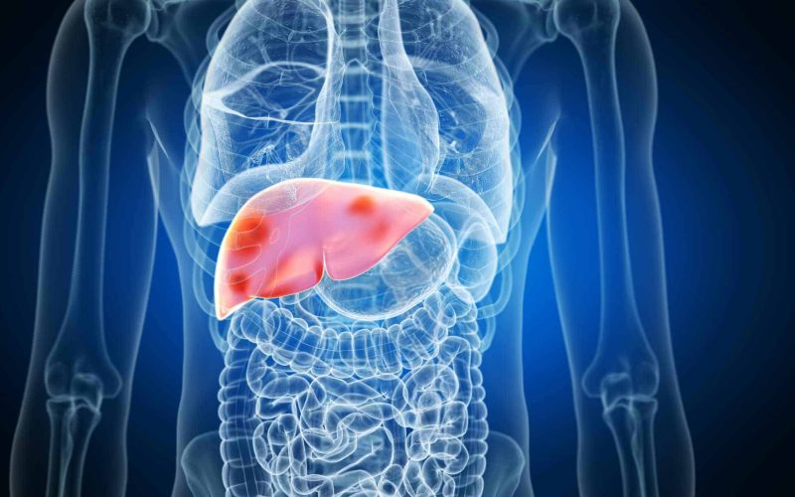
LIVER DISEASE CLASSIFICATION
Project P475: Group 5
Classification Project: Predict Liver Disease
The variable to be predicted is categorical (no disease, suspect disease, hepatitis c, fibrosis, cirrhosis).

Slide 2

Mentor & Dedicated Team
Macha Kedharnath
Paradesi Anisha Preethi
Priyanka More
Uzair Pandith
Akshata Shivarai
Vyshnavi Nallagopu
Shinde Sanjana Bhaskar

Slide 3
Table of Contents
Objective and Dataset Overview
Exploratory Data Analysis and Data Pre-processing
Feature Engineering
Data Balancing
Model Building
Model Comparison
Model Deployment
Conclusions

Slide 4

Objective and Dataset
To develop a classification model to predict the health status of individuals based on diagnostic variables. The target variable categorizes health status into five classes: No Disease, Suspect Disease, Hepatitis C, Fibrosis, and Cirrhosis.
Data Set Overview:
Instances (Rows): 615
Variables (Columns): 13 (predominantly numeric, one binary - Sex)
Target Variable: Health status with five categories: No Disease, Suspect Disease, Hepatitis C, Fibrosis, Cirrhosis
Key Features:
Demographics: Age, Sex
Biomarkers: Albumin, Bilirubin, Cholesterol, Protein
Enzymes: Alkaline Phosphatase, ALT, AST, GGT
Other: Cholinesterase, Creatinine
Most variables represent measurements from blood and urine analyses, aiding in diagnosing liver and kidney-related conditions.

Slide 5
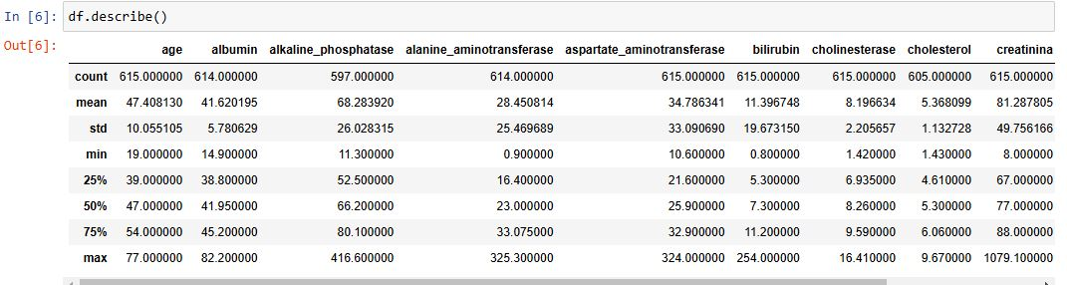
Dataset Description
Target Variable:
The target variable is categorical and includes categories like No disease, Suspect disease, Hepatitis C, Fibrosis, and Cirrhosis. This makes it a classification problem.
Insights for Analysis:
The variability in biomarkers provides crucial indicators for distinguishing between disease categories.
Features like age, enzymes (ALT, AST), and biomarkers are likely to be strong predictors for classification.
Outliers:
Significant outliers in variables like Bilirubin (max: 254 mg/L) and Creatinine (max: 1079 µmol/L) could correspond to severe medical conditions.
These outliers will need to be carefully addressed during preprocessing.

Slide 6
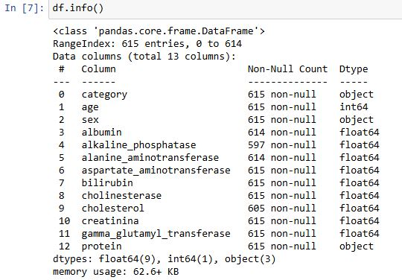
Dataset Description
The data types include:
float64 (9 columns)
int64 (1 column)
object (3 columns).
Most columns have complete data, but there are missing values in 2 columns:
albumin (614 non-null values out of 615).
alanine_aminotransferase (614 non-null values out of 615).

Slide 7
Exploratory Data Analysis
Problem Understanding
Data Preparation / Exploration
Model Building
Model Evaluation
Model Deployment
Input: Raw Data
Output: Enriched Data
Data Visualization
EDA

Slide 8

Handling Missing Values
Categorical Data Imputation:
Missing values in categorical columns are replaced with the mode (most frequently occurring value), ensuring consistency and retaining the most representative category.
Numerical Data Imputation:
Missing values in numerical columns are replaced with the median, as it is robust against outliers and provides a central value for the distribution.
Column-wise Imputation:
A systematic approach is applied to handle missing values for all columns in the dataset, ensuring that both categorical and numerical features are processed appropriately, maintaining data integrity.

Slide 9
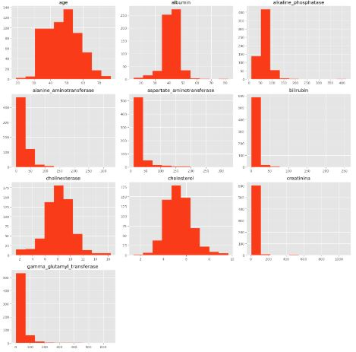
Univariate Analysis
Insights into Data Distribution:
Most numerical features, such as age, albumin, and cholesterol, show relatively normal or skewed distributions.
Some features, like bilirubin and gamma_glutamyl_transferase, exhibit highly skewed distributions, indicating the presence of outliers or non-normality.
Actionable Observations:
Skewed features may require log transformation or other scaling techniques to normalize their distributions.
Features with outliers, like alkaline_phosphatase and bilirubin, might benefit from outlier detection and treatment strategies.
Feature-Specific Patterns:
The age feature shows a balanced spread, while certain features, like aspartate_aminotransferase, are concentrated around lower values.

Slide 10
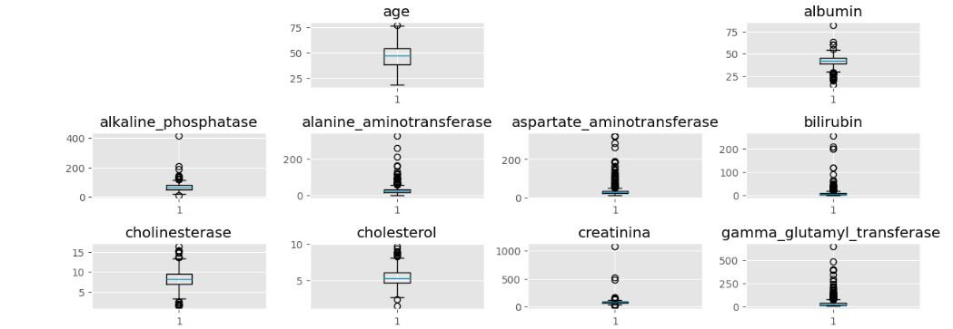
Outlier Detection Using Boxplots
Key Observations:
Age and albumin display fewer outliers compared to other features, suggesting relatively consistent data distribution.
Features like creatinina and cholesterol have extreme outlier values, which may need closer inspection for validity.
Insights:
Several features, such as alkaline_phosphatase, bilirubin, and gamma_glutamyl_transferase, show a significant presence of outliers.

Slide 11
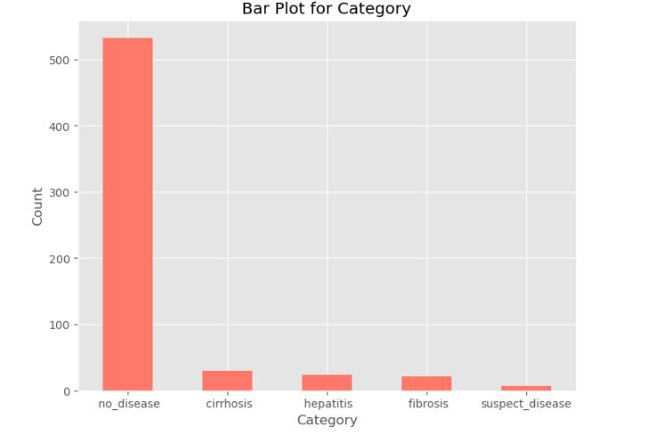
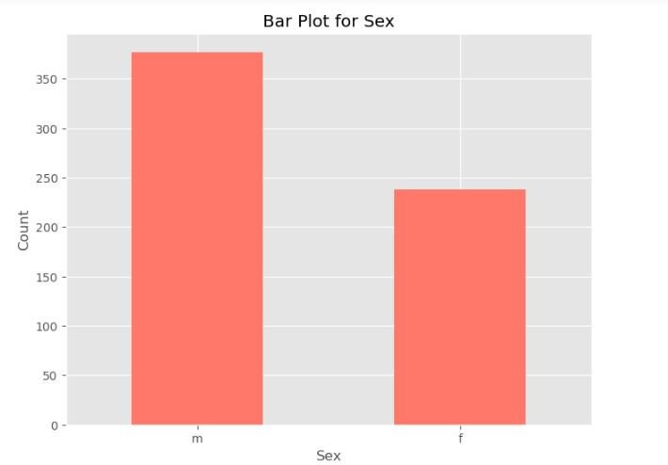
Barplots: for Category & Sex
Bar Plot for Category:
The "no_disease" category has the highest count, indicating a majority without diagnosed health issues.
Other categories like cirrhosis, hepatitis, fibrosis, and suspect disease have significantly fewer cases.
Bar Plot for Sex:
The majority of individuals are male (m).
Fewer individuals are female (f).
Highlighted imbalance in gender representation.
Insights:
Imbalances in gender and category data could influence the analysis or model performance.
Dataset preprocessing or stratified sampling might be necessary to address class imbalances.

Slide 12
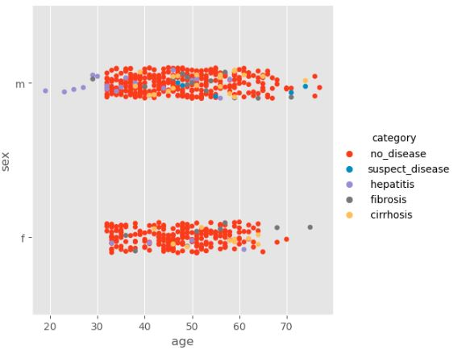
Disease Ratio/Visualization With Respect To Age And Gender
Disease Prevalence by Age and Gender:
Helps identify which diseases are common in specific age groups.
Highlights gender-specific trends in disease occurrence.
Category Clustering:
The spread of points across ages can show clustering for certain categories.
For example, diseases like cirrhosis or hepatitis may concentrate in specific age ranges.
Gender Differences:
Visualizes whether some conditions are more common in males (m) or females (f).
Age Gaps:
Identifies any gaps in the dataset, such as missing data for certain age ranges.

Slide 13
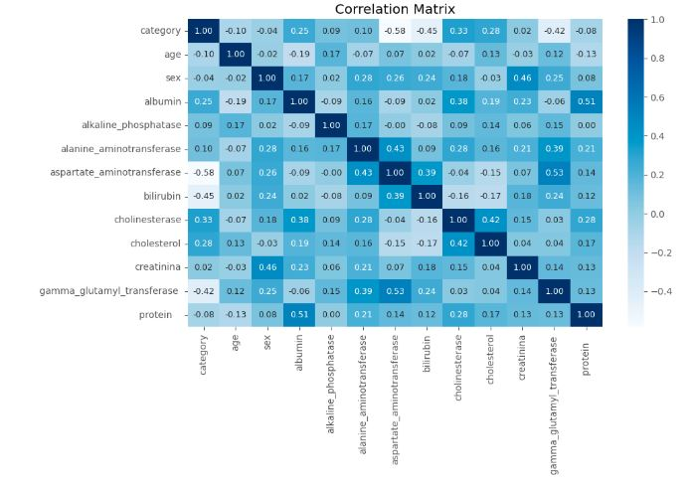
Correlation Matrix & Feature selection for Dimensionality Reduction
Insights:
If you see correlation values more than 0.7 then you can drop any one of the feature as both the values represent a similar pattern.
Any attribute whose range is above +0.05 or -0.05 that attribute will have some importance with the variable.
By removing highly correlated features, you can reduce dimensionality, improve model interpretability, and potentially enhance model performance by reducing noise and overfitting

Slide 14
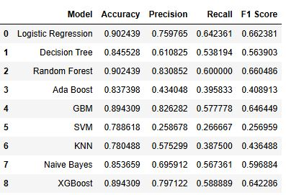
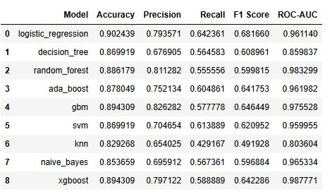
Model Building And Accuracy Comparison
Final Results
With Hyper parameter Tuning
Without Hyper parameter Tuning

Slide 15
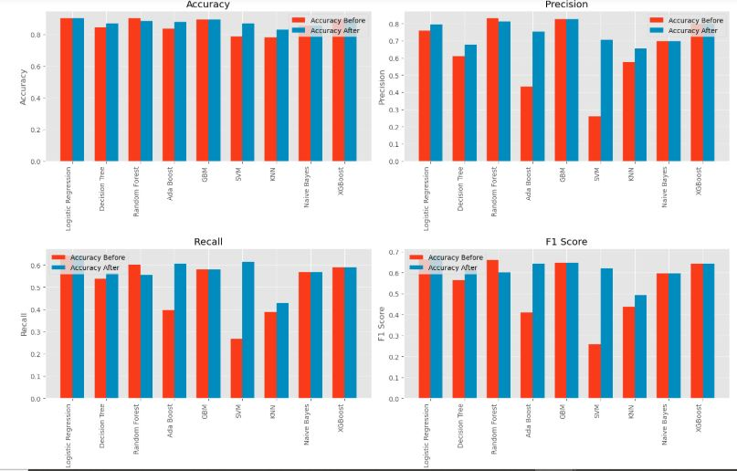
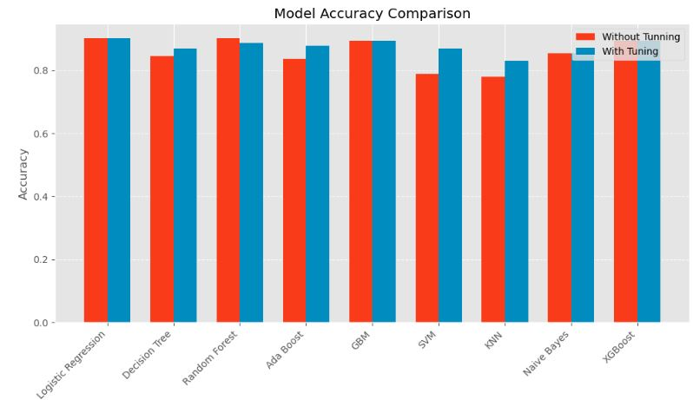
Model Evaluation & Model Selection
Why Logistic Regression was Selected?
Best Accuracy: Achieved the highest accuracy of 91.06%.
High Recall: Demonstrated the best recall (64.44%) among all models, making it suitable for identifying positive cases effectively.
Best F1-Score: With an F1-score of 68.94%, it strikes a good balance between precision and recall.
Strong ROC-AUC: Achieved an impressive ROC-AUC score of 96.19%, indicating excellent discrimination ability between classes.
Robust to imbalanced data

Slide 16
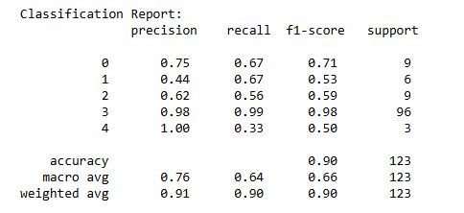
Model Implementation
Advantages of Logistic Regression:
Simple and interpretable model for binary and multiclass classification.
Robust to imbalanced data and gave good results as compared to other models.
Model Storage:
The saved model can be deployed for real-time predictions or loaded for further analysis.
Evaluation Metrics:
The classification report helps in identifying model strengths and areas for improvement (e.g., low recall for certain classes).

Slide 17
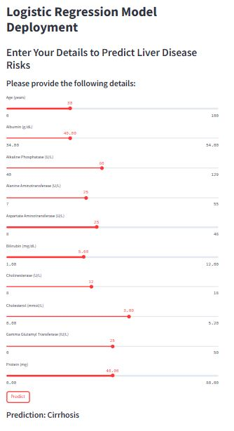
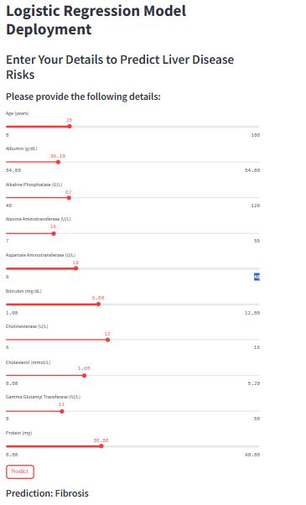
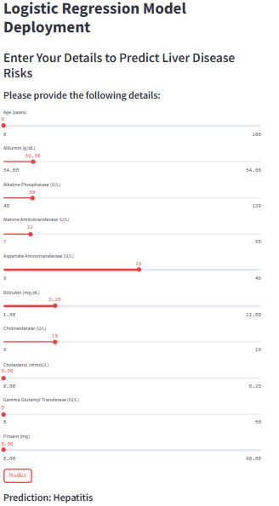
Deployment

Slide 18
CHALLENGES
1. Handling Missing Data
Challenge: Missing values in medical datasets can mislead the model’s learning process and result in inaccurate predictions.
Solution: We used appropriate imputation techniques like filling with the median for numerical data. In cases where too much data was missing, we removed incomplete rows to preserve data quality.
2. Dealing with Categorical Variables:
Challenge: Converting categorical data (e.g., gender or disease categories) into a numerical format can be complex, especially if the data has multiple unique values.
Solution: We used label encoding for binary variables like sex and one-hot encoding for multi-class variables like disease categories, ensuring that the model correctly interprets them.
3. Outlier Detection:
Challenge: Outliers, which may represent unusual patient conditions, can skew the data and lead to incorrect model predictions.
Solution: We used the IQR method to detect outliers. Where necessary, we capped extreme values to maintain data integrity without removing valuable information.
4. Handling Imbalanced Data:
Challenge: The given dataset was highly imbalanced with one of the class dominating the others.
Solution: We applied custom smote technique to overcome this and allowed it to generate more realistic synthetic data points.

Slide 19
CONCLUSION
Predicting liver diseases is vital for catching problems early and providing timely treatment. It helps prevent serious conditions, reduces the need for invasive procedures, and improves patients' quality of life.
By identifying risks early, we can take better care of patients and lower healthcare costs in the long run.
By combining innovative algorithms and efficient data processing, it can significantly enhance user satisfaction and platform loyalty.

Slide 20


